Slide 1

Escaping the clone zone: java runtime-managed snapshots
Matthew C. Davis
East Carolina university
SERPL 2019 – Augusta, GA
May 11, 2019

Slide 2


Organization of this Presentation
Background
Motivation
Previous work
Current Work
Future Work
20 Minutes
10 Minutes
Photos by Unknown Author licensed under CC BY-NC except where noted otherwise

Slide 3


Background

Slide 4
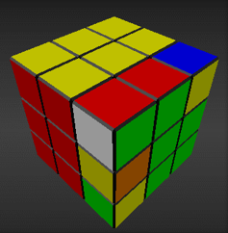


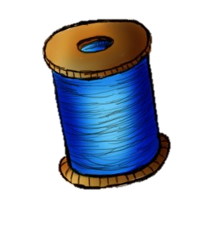
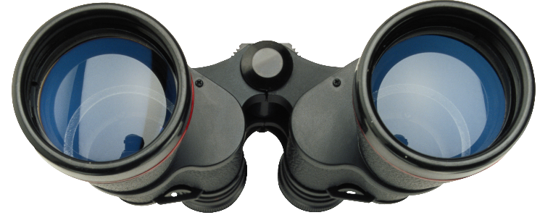



IMMutable objects
Not modified
String
“SER”
String
“PL19”
.concat(
)
New String
String
“SERPL19”

Slide 5


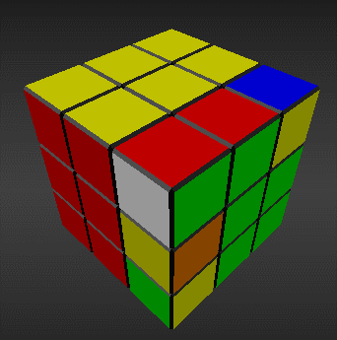



Designing Mutable objects

Slide 6


Using Shared Mutable Objects
COPY
Worklist
Worklist
.clear()
Worklist
.addAll( )
COPY
Worklist
server
client

Slide 7

Native java options
Under-specified semantics
(clone, copy constructor)
Not universal
(serialize, clone, copy constructor)

Slide 8

Motivation

Slide 9

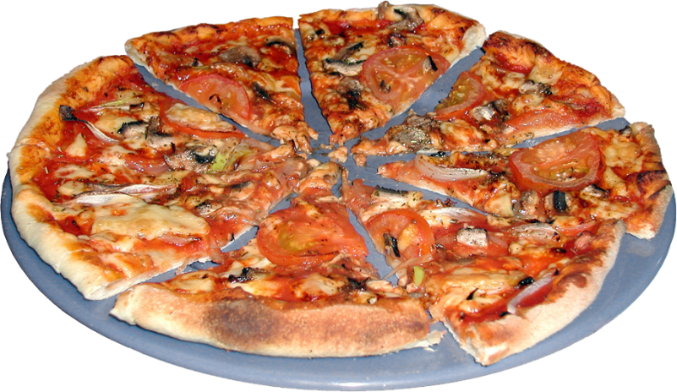

Motivation
Propose a universal method to guarantee non-shared state with predictable semantics.

Slide 10

Previous work

Slide 11
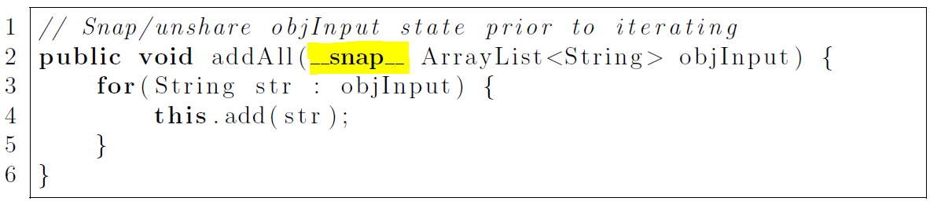
basic idea
Formal parameter modifier: __snap__
Runtime guarantees non-shared state
Type independent
Predictable depth of copy

Slide 12
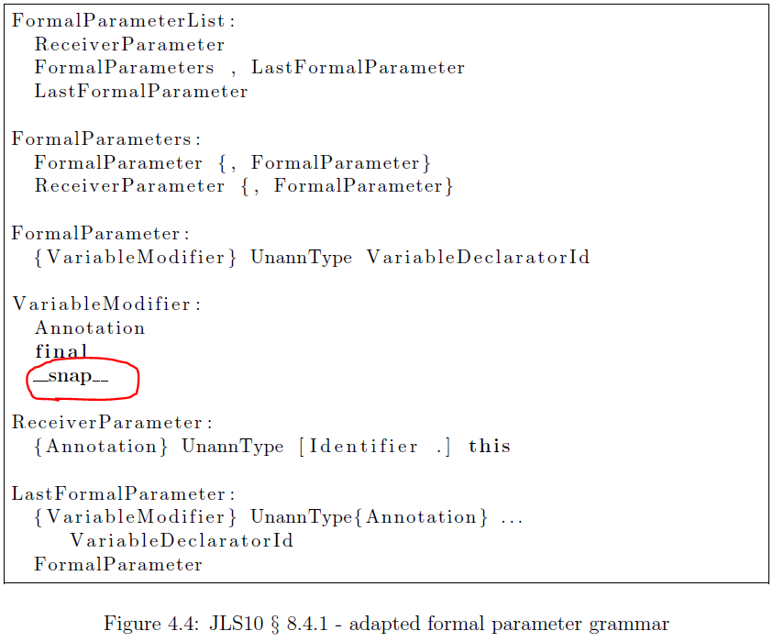
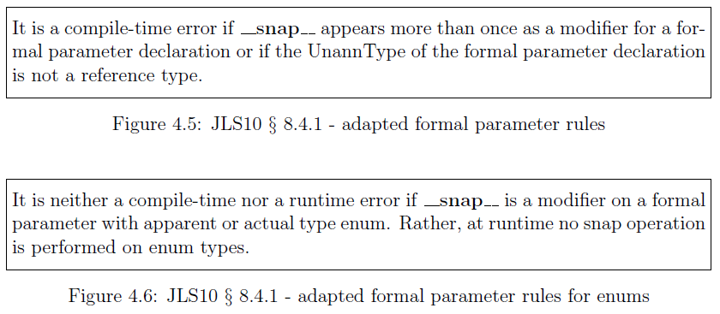

Java Language Specification Proposal
§ 3.9 – Keyword list: add __snap__
§ 8.4.1 – Formal parameter grammar

Slide 13
Two Experiments
Transformation Transform the expanded grammar (__snap__) to standard Java 10 code. Scope: Create a pre-processor. No changes needed to JDK
Modify OpenJDK Implement the new modifier directly in JDK Scope: Compiler, Java Bytecode, Java Virtual Machine

Slide 14
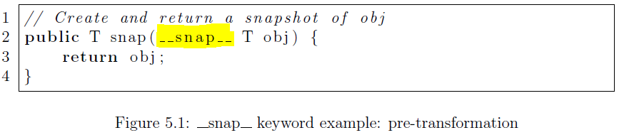
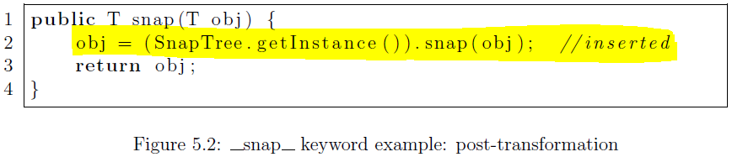





Experiment #1: Transformation
A transformation approach accepts code in an enriched syntax or Domain-Specific Language (DSL) and transforms the input to another, usually standard, language.
clone()
Serialize

Slide 15
Quickly Ran into Problems
Not universal
Not mandatory for objects to be: Cloneable, Serializable, or … Copy-Constructer-able
Not predictable
Serialization and Clone() yield different results depending on type.
CloneNotSupported and NotSerializable exceptions.
Key point: Transformation not viable here

Slide 16





Experiment #2: Modify OpenJDK directly
Basic Idea:
Implement __snap__ modifier and snapshotting directly in OpenJDK

Slide 17
Experiment #2: Modify OpenJDK
Steps for Experiment:
Specify a new bytecode, 0xcb asnap → Triggers object snapshotting within the Java Virtual Machine
Modify the Java compiler (parse and generate phases) → Emit 0xcb when loading actual parameters declared w/modifier __snap__
Modify the HotSpot JVM’s bytecode interpreter → Snapshot object on operand stack when encountering 0xcb bytecode

Slide 18




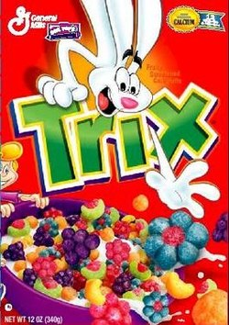


What is the relative performance?
In this evaluation:
Focused on steady-state performance
Disabled JIT compilation (adapting c1 and c2 compilers are future work)
Garbage collected before each measured operation
Evaluation is x64-only due to native x64 assembly code
Large & Small inputs evaluated.
JIT
Notes:
Literature clearly observes the difficulty of evaluating Java performance.
Java Virtual Machine is notoriously non-deterministic from a performance standpoint:
Garbage Collection, Just-in-time Compilation, Thread scheduling, Optimizations, etc
Challenging to draw conclusions about performance. “Tricky Results”

Slide 19
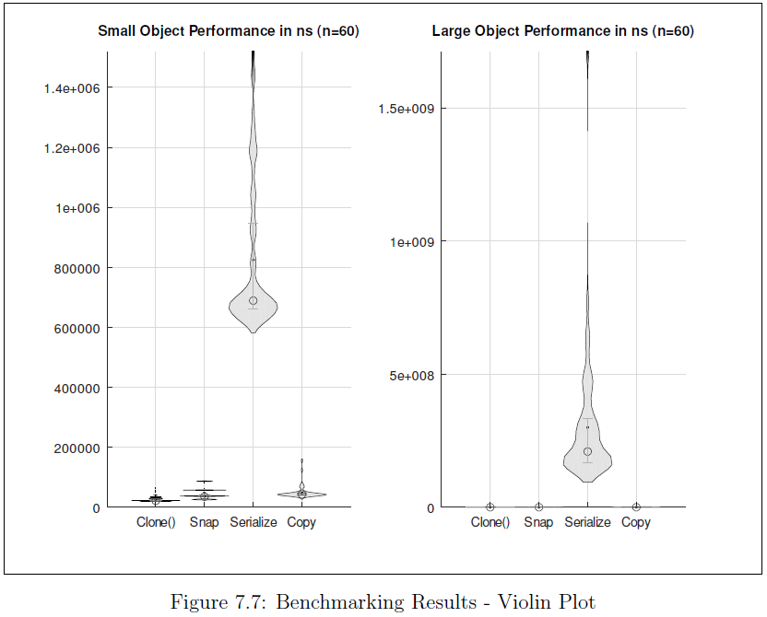


Slide 20
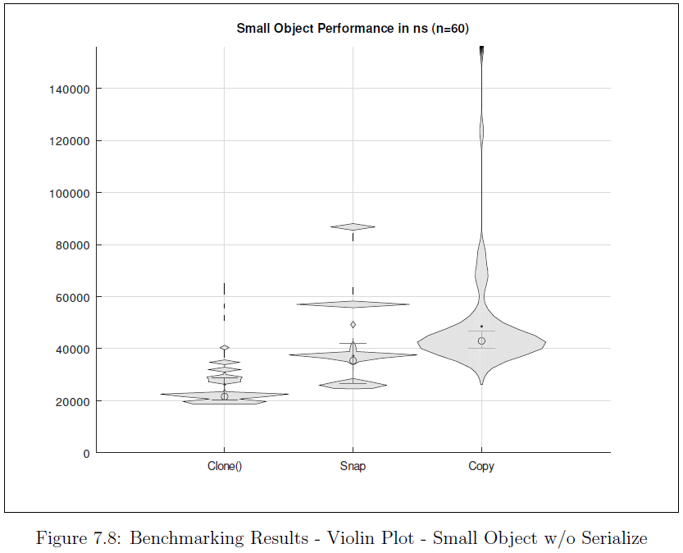
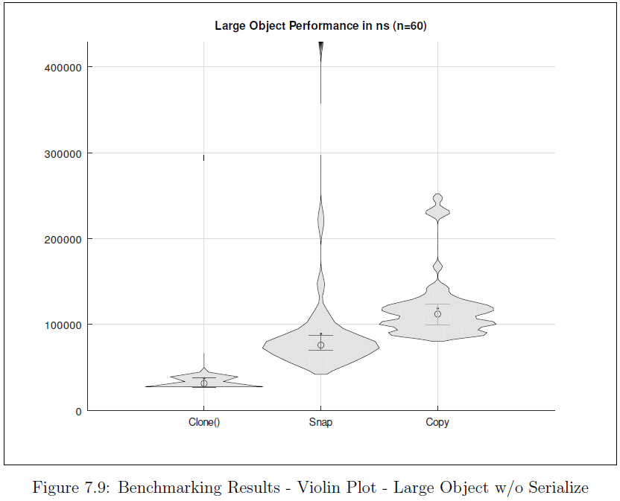


Slide 21
Previous work summary
At the end:
Had a working prototype based on OpenJDK 10 → Implemented __snap__ and 0xcb in javac and HotSpot JVM
That was performant → Relative to extant methods
And provided consistent semantics for all objects

Slide 22

Current work

Slide 23
Current Research questions
R1. How frequently are clone(), serialize(), copy constructor, copy libraries used?
Not well understood
R2. What is the distribution of
Java object graph depths?
Not well understood

Slide 24

Plan of current work
R1. ƒ()
Locations:
Clone
Serialize
Copy Constructor
Copy Library
n Most Starred
Rascal
MPL
Rascal: Inject
Annotations
Into Source
Annotations
Trigger Depth Check
Execute: Output Depth Metrics
R2. Graph Depth
Metrics

Slide 25

Future work

Slide 26
plenty of Work for the future
Escape Analysis
Bytecode Verification
Simplify Snapshot Load
Differential
Snapshots
Platform Independence
C1 and C2 Compilers
Adapt Remaining JDK Tools
Type Exclusions

Slide 27

Q & A

Slide 28
Thank you

Slide 29
Backup slides

